Slide 1

RETAIL INSIGHTS FROM SUPERSTORE DATASET
Madhumidhra M
K.L.N College Of Engineering

Slide 2

PROBLEM STATEMENT
Superstore operates across multiple countries with numerous branches, and it is essential to analyze the overall sales and profit for each country to evaluate the performance and efficiency of the superstore.
By examining all attributes, this analysis will help increase the market share and annual profit sales across each country and provide actionable insights for better business strategies.

Slide 3
PROJECT DESCRIPTION:
The project aims to extract meaningful insights from the dataset through various analytical steps.
These steps include summarizing the dataset's basic structure, analyzing sales and profit performance by region, segment, and product category, and evaluating the impact of discounts and shipping modes on sales and profit.
Additionally, the project examines quantities sold to manage inventory effectively.
By creating visualizations such as bar charts, pie charts, and scatter plots, the analysis provides actionable insights that will enhance business strategies, increase market share, and boost annual profit sales across each country.

Slide 4

WHO ARE THE END USERS?
Retail Management
Sales and Marketing Teams
Supply Chain and Operations Teams
Data Analysts and Business Analysts
Investors and Shareholders

Slide 5

TECHNOLOGY USED:
Python: For data analysis and scripting.
Pandas: For data manipulation and analysis.
NumPy: For numerical operations and handling large datasets.
Matplotlib: For creating visualizations.
Google Colab: For interactive coding, visualization, and documentation.

Slide 6
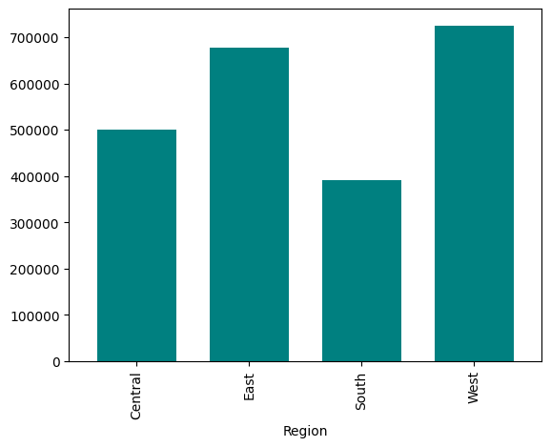
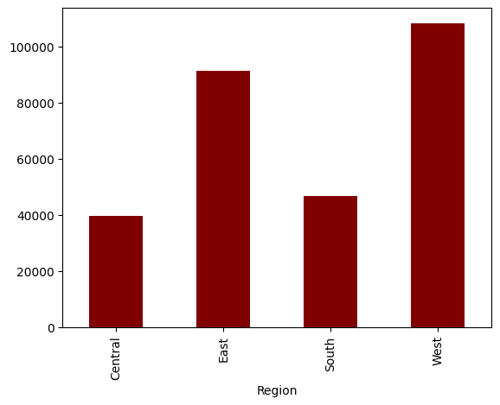
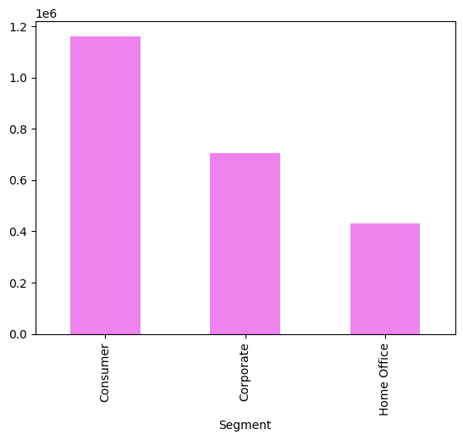
RESULTS:
Sales analysis based on region
Profit analysis based on region
Sales analysis based on segment

Slide 7
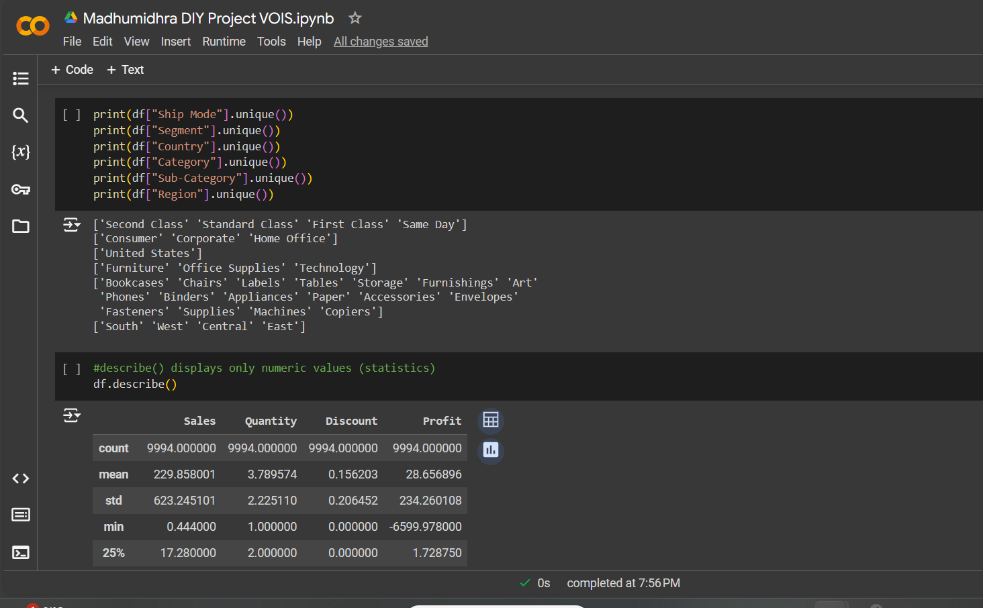
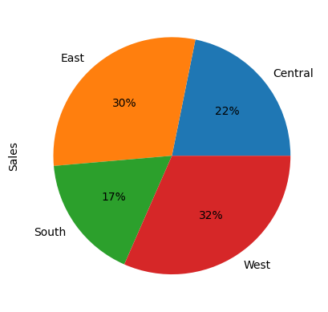
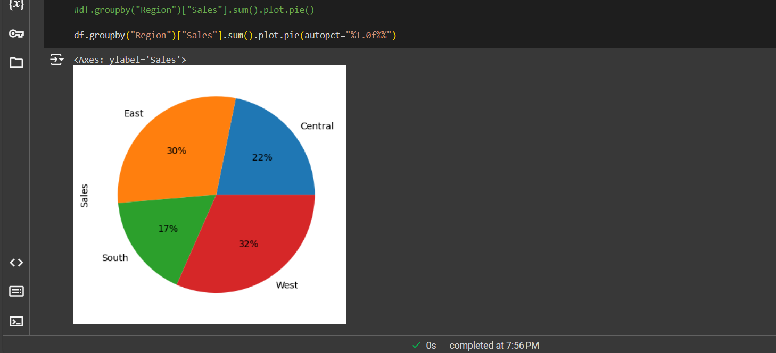
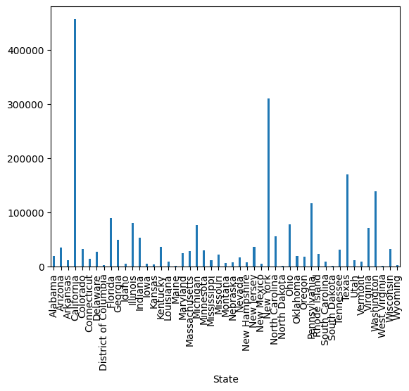
Sales analysis based on region
Code Snippets
Sales analysis based on State

Slide 8
THANK YOU!
This project provides a thorough examination of retail data to reveal trends and insights that support improved business decisions. By leveraging Python and its libraries, the project delivers actionable insights to key stakeholders, driving growth and profitability for the retail business.
PROJECT LINK AS COLAB NOTEBOOK
PROJECT LINK AS VIDEO
Project Demo
Retail Store Analysis
DATASET USED FOR THE PROJECT
Sample Superstore Dataset

